Slide 1

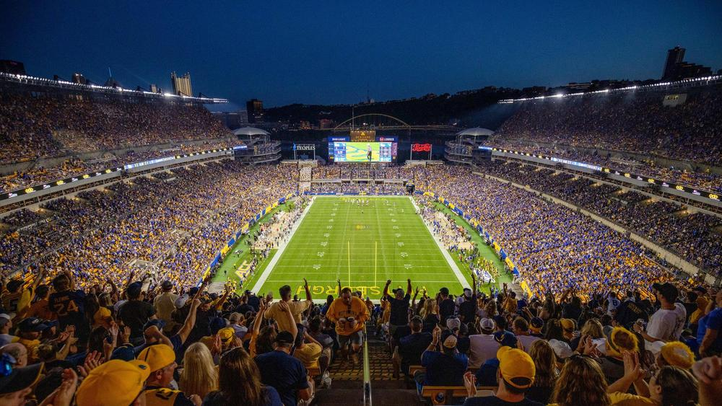
NFL Games: What factors influence the outcome?
Melissa Mayer
Matthias Boles
Justin Lawrence
Brian Nagle

Slide 2
Introduction
Our group has set out to discover what factors may influence the outcome of the NFL game. We examined if a correlation exists between home-field advantage and the win/loss record and total scores of NFL games since 1966. We also examined variables such as weather, surface type, and stadium variations to determine which factors had the greatest impact.

Slide 3
Data Preparation
Raw dataset was downloaded from
NFL scores and betting data (kaggle.com)
Two csv files were merged to give a single dataframe containing
•Scores from every NFL game since 1966 season
•Stadium type (indoor or outdoor)
•Stadium surface (grass or non-grass)
•General weather conditions (warm, moderate or cold)
•Specific weather conditions for each game (wind speed, temperature, humidity)
Calculations were carried out to give the following additional information
•Numbers of wins or losses and ties
•Total score in each game

Slide 4


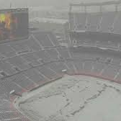
Questions:
What is the home team winning percentage?
Regular Season vs Playoff Win Percentage
Does weather affect outcome?
Grass vs turf?
Open stadium vs. dome?
How is the total score impacted by windspeed and temperature?
Average Point Score and Temperature

Slide 5
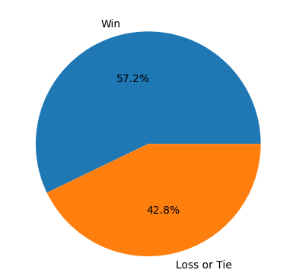
Home Team percentage of wins 1966- present

Slide 6
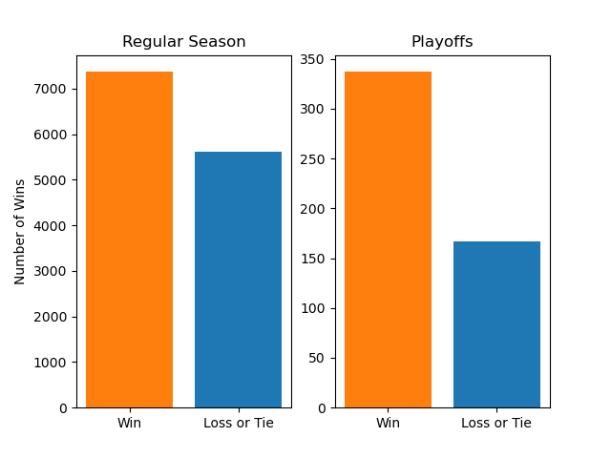
Home Field Advantage Regular Season and Playoffs

Slide 7
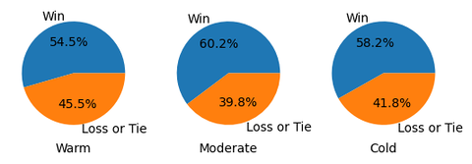
Weather

Slide 8
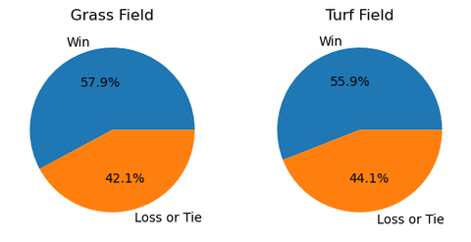
Grass Vs. Turf

Slide 9
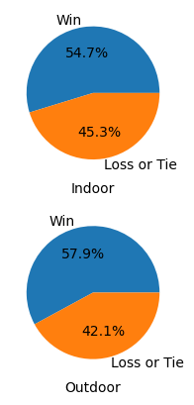
Outdoor Stadium vs indoor Stadium
NFL Teams with Indoor Stadiums
State Farm Stadium | Arizona Cardinals. ...
Mercedes-Benz Stadium | Atlanta Falcons. ...
AT&T Stadium | Dallas Cowboys. ...
Ford Field | Detroit Lions.
NRG Stadium | Houston Texans. ...
Lucas Oil Stadium | Indianapolis Colts. ...
Allegiant Stadium | Las Vegas Raiders.

Slide 10
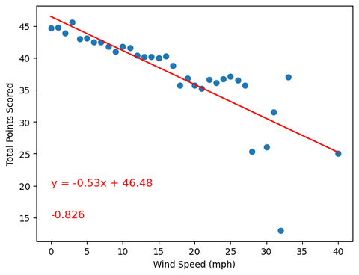
Total Points Scored and Windspeed

Slide 11
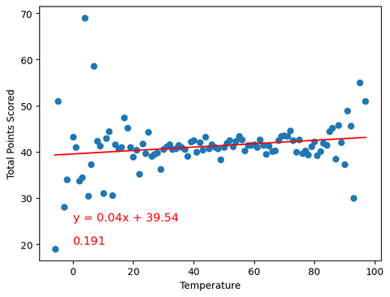
Average points Scored and Temperature

Slide 12
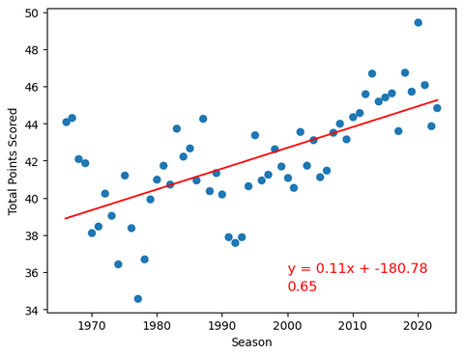
Average Points Scored Per Season

Slide 13
Conclusion
What is the home team winning percentage? The home team wins 57% of the games played since 1966.
Regular Season vs Playoff Win Percentage- Based on the data, the home team has a higher winning percentage in the regular season and in the playoffs.
Does weather affect outcome? In moderate and cold temperatures, the home team has a higher winning percentage than in warmer weather.
Grass vs turf? Teams who play on grass have a higher winning percentage than those teams who play on turf.
Open stadium vs. dome? Home teams who play in outdoor stadiums have a higher winning percentage than those teams who play in a dome stadium,.
How is the total score impacted by windspeed and temperature? There is a negative overall correlation between total average score and windspeed with an r value of -0.826
Is Average Point Score and Temperature? There is a minimal correlation between temperature and average points scored

Slide 14
The Ideal Stadium Based on the Data
The ideal stadium will include the following variables
Weather: Moderate
Field: Grass
Stadium: Outdoor
Windspeed: Low

Slide 15
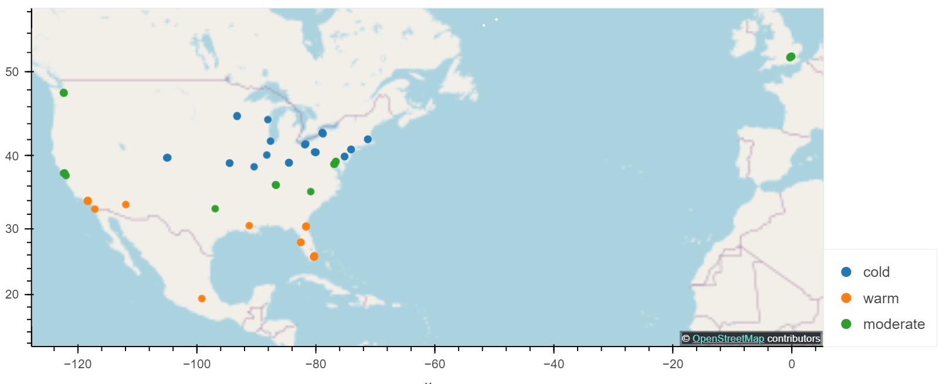
Location of Outdoor Stadiums by Weather

